Slide 1


$2^{p}$factorial experiments
Antonio Osamu Katagiri Tanaka A01212611
Diego Sebastian Ceciliano Franco A01373414
Carlos Cardoso Isidoro A01750267
Jesús Alberto Martínez Espinosa A01750270

Slide 2


$2^{p}$ factorial experiments vs complete factor
Determine which factors have an important effect on the outcome
When studying factors simultaneously each factor two levels
that’s why $2^{p}$
$$2^{10}=1024$$
High Low

Slide 3
Notation
Main effects
A, B, and C
Two-way interactions
AB, AC, and BC
Three-way interactions
ABC
Treatments (a letter indicates high level)
ab = the first two factors are at their high level
1 = All factors are at their low levels
k = replicates for each treatment
Cell mean = the average of the k observations

Slide 4
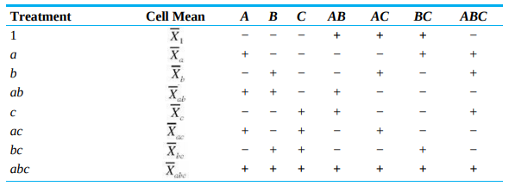

Sign table
Table 1: Sign table for a $2^{3}$ factorial experiment

Slide 5
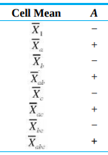

Estimating effects
$$Estimated mean response for A at its high level=$$
$$\frac{1}{4}(\overline{X}a+\overline{X}ab+\overline{X}ac+\overline{X}abc)$$
$$Estimated mean response for A at its low level=$$
$$\frac{1}{4}(\overline{X}1+\overline{X}b+\overline{X}c+\overline{X}bc)$$
$$A effect estimate=$$
$$\frac{1}{4}(\overline{X}a+\overline{X}ab+\overline{X}ac+\overline{X}abc−\overline{X}1−\overline{X}b−\overline{X}c−\overline{X}bc)$$
Contrast of factor A

Slide 6
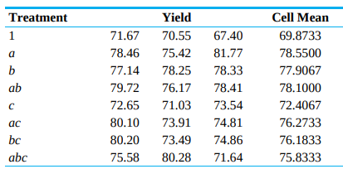
Example
Table 2: Factors of a chemical reaction

Slide 7
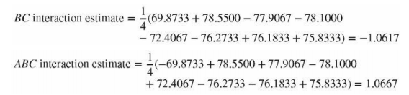
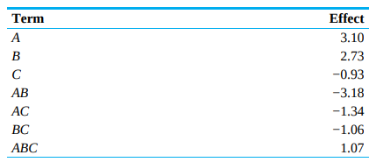
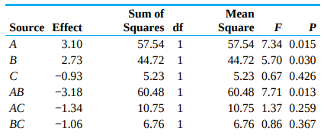


Example
$$Sum of squares for an effect= \frac{k{(contrast)}^{2}}{8}$$
Mean square $= \frac{k{(contrast)}^{2}}{8n}$

Slide 8


Interpreting Computer Out
Estimating Effects in a $2^{p}$ Factorial Experiment
Values:
1 High level
-1 Low level
$$Effect Estimate=\frac{contrast}{2^{p−1}}$$
Where signs can be used to estimate:
+ Treatments where the factor is in high level
- Treatments where the factor is in low level

Slide 9


Estimating Effects in a $2^{p}$ Factorial Experiment
Probability Plots to Detect Large Effects
$$SSE=(K−1)\sum_{i=1}^{2p}{s_{i}^{2}}$$
$$Sum of squares for an effect=\frac{K{\left(contrast\right)}^{2}}{2^{p}}$$
The Main effects and interactions whose estimate plot far from the line are the ones most likely to be important

Slide 10
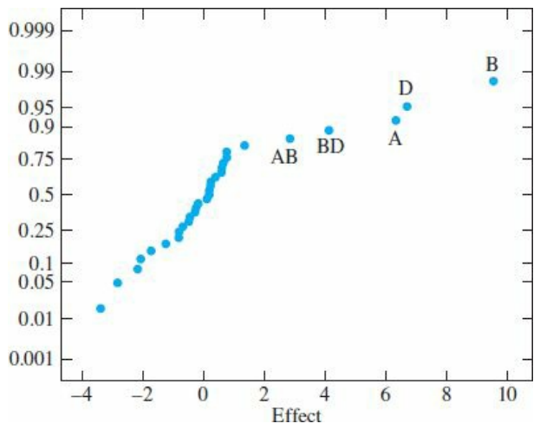
Figure: Normal probability plot of the effect estimates. The main effects of factors A, B and D stand out as being larger than the rest.

Slide 11
Fractional Factorial Experiments
When the number of factors is large, observations may be taken only for some fraction of the treatments.
If treatments are chosen correctly it is possible to obtain information about the factors.
When the factor has 2 levels. The fraction must be in power of two.
Half replicate = Half treatments are used.
Quarter replicate = One Quarter treatments are used

Slide 12
Treatment | A | B | C | D
1 | - | - | - | -
a | + | - | - | -
b | - | + | - | -
ab | + | + | - | -
c | - | - | + | -
ac | + | - | + | -
bc | - | + | + | -
abc | + | + | + | -
d | - | - | - | +
ad | + | - | - | +
bd | - | + | - | +
abd | + | + | - | +
cd | - | - | + | +
acd | + | - | + | +
bcd | - | + | + | +
abcd | + | + | + | +
Sign table for the main effects.
The experiment will have 8 treatments chosen from 16

Slide 13

Treatment | A | B | C | D
1 | - | - | - | -
a | + | - | - | -
b | - | + | - | -
ab | + | + | - | -
c | - | - | + | -
ac | + | - | + | -
bc | - | + | + | -
abc | + | + | + | -
To chosose the 8 treatments is necessary to start with a sign table for a $2^{4}$ design that shows the signs for the main effects and the highest order interaction.

Slide 14
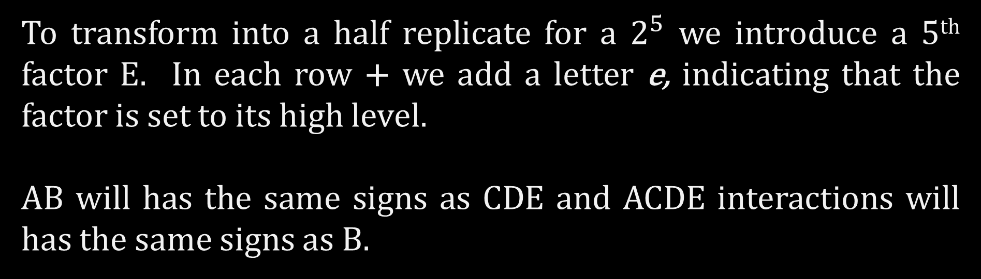
Fractional Factorial Experiments
To transform into a half replicate for a $2^{5}$ we introduce a 5th factor E. In each row + we add a letter e, indicating that the factor is set to its high level.
AB will has the same signs as CDE and ACDE interactions will has the same signs as B.

Slide 15
Treatment | A | B | C | D | E=ABCD | AB | CDE | ACDE
e | - | - | - | - | + | + | + | -
a | + | - | - | - | - | - | - | -
b | - | + | - | - | - | - | - | +
abe | + | + | - | - | + | + | + | +
c | - | - | + | - | - | + | + | -
ace | + | - | + | - | + | - | - | -
bce | - | + | + | - | + | - | - | +
abc | + | + | + | - | - | + | + | +
Used for more elaborated experiments.
Listing the estimates in decresing order and looking to see if there are a few that are noticeably larger.

Slide 16
Conclusions:
This kind of experiments not only allow to asses the effect of each factor on the outcome but also the effect of their interactions.
The main effects and interactions whose estimates the plots far from the line of the plot are the most likely to be important.
The use for a Fractional Factorial Experiments serves to identify few factors that have greatest impact on the outcome.

Slide 17
References
Navidi, W. C. (2008). Statistics for engineers and scientists (pp. 344-354). New York, NY, USA: McGraw-Hill Higher Education.

